Slide 1
Nutritional Considerations for Intense Training and Sports Competition

Slide 2
Objectives
Describe a meal that you would prepare for an athlete before an athletic event
Define glycemic index and provide examples of low, moderate, and high glycemic index foods
Compare and contrast carbohydrates before, during, and after exercise

Slide 3
The pre-athletic event meal
Readily digestible foods
Should contribute to energy and fluid requirements
Meals high in carbohydrates and low in lipids and proteins
Three to 4 hours to digest and absorb the meal

Slide 4
Ideal pre-athletic event meal
The ideal pre-athletic event meal:
Contains 150 – 300 grams of carbohydrates
Is consumed 3 to 4 hours before the event
Contains little fat
Contains little fiber

Slide 5
Liquid meals
High in carbohydrates
Supply fluids
Rapidly digestible
Can be used for day-long events
Supplement calorie intake in those with difficulty maintaining body weight

Slide 6
Nutrition bars
High protein content
Approximately 25g of carbohydrate
Often include vitamins and minerals
May contain dietary supplements
Should not substitute for normal food intake
Notes:
.

Slide 7
Nutrition powders and drinks
High protein content
Contain vitamins, minerals, and other dietary supplements
Come in powdered form
Contain fewer calories per serving than nutrition bars

Slide 8
Carbohydrates before exercise
If simple sugars are consumed, they should be consumed at least 60 minutes prior to exercise
Fructose absorbs more slowly compared with glucose or sucrose
Risk of gastrointestinal distress

Slide 9
Carbohydrates during exercise
Allows for a greater intensity during prolonged activities
Consuming about 60g of liquid or solid carbohydrates each hour benefits:
High-intensity, long-duration aerobic exercise
Repetitive short bouts of exercise
Spares muscle glycogen
Helps maintain blood glucose levels

Slide 10
Carbohydrates after exercise
High-glycemic, carbohydrate-rich foods
A single large meal or small frequent meals with replenish glycogen stores
Should be consumed as soon as possible after exercise
Avoid legumes, fructose, and milk products

Slide 11
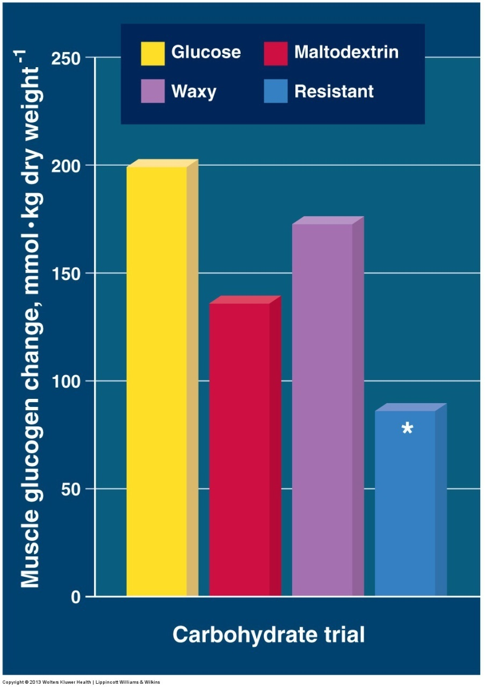
Notes:
Changes in muscle glycogen with various carbohydrate feedings of similar energy content in the 24-hour period following glycogen-depleting exercise.
* Denotes significantly lower value than glucose, maltodextrin, and waxy starch.

Slide 12
Glycemic index
Indicates how a carbohydrate-containing food affects blood glucose levels
High-glycemic index (70 or more)
Examples: white bread, corn flakes
Moderate-glycemic index (56-69)
Examples: brown rice, quick oats
Low-glycemic index (55 or less)
Examples: most fruits, non-starchy vegetables

Slide 13
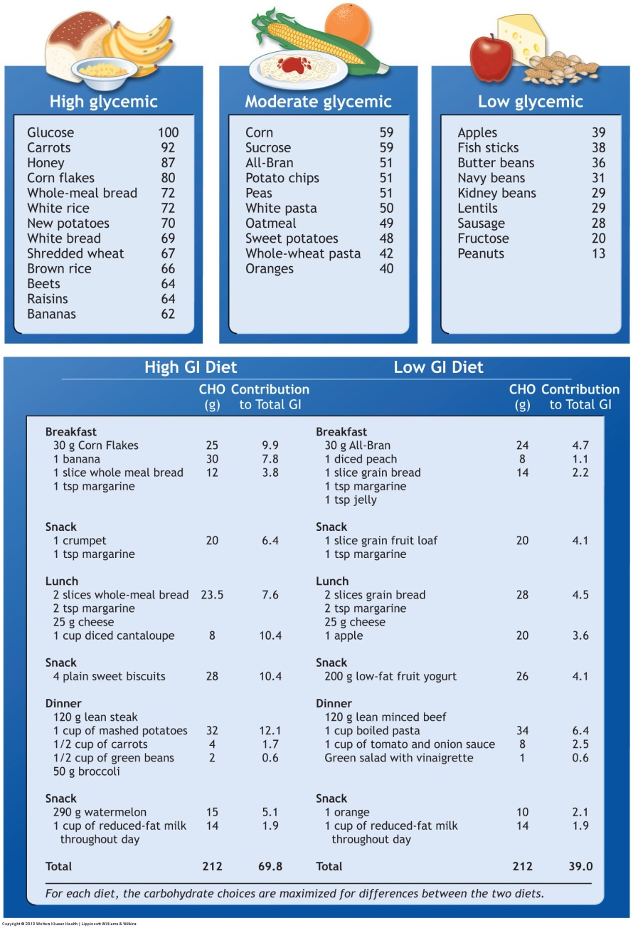
Notes:
Glycemic index categorization of common food sources of carbohydrates.

Slide 14
Glycogen depletion
High-intensity aerobic exercise for 1 hour decreases liver glycogen by about 55%
A 2-hour strenuous workout nearly depletes the glycogen content of the liver and specifically exercised muscles

Slide 15
Solutions for glycogen repletion
Carbohydrate-containing solution consumed during exercise enhance endurance performance by maintaining blood sugar concentration
Glucose supplied in the blood can:
Spare existing glycogen in active muscles
Serve as “reserve” blood glucose for later use

Slide 16
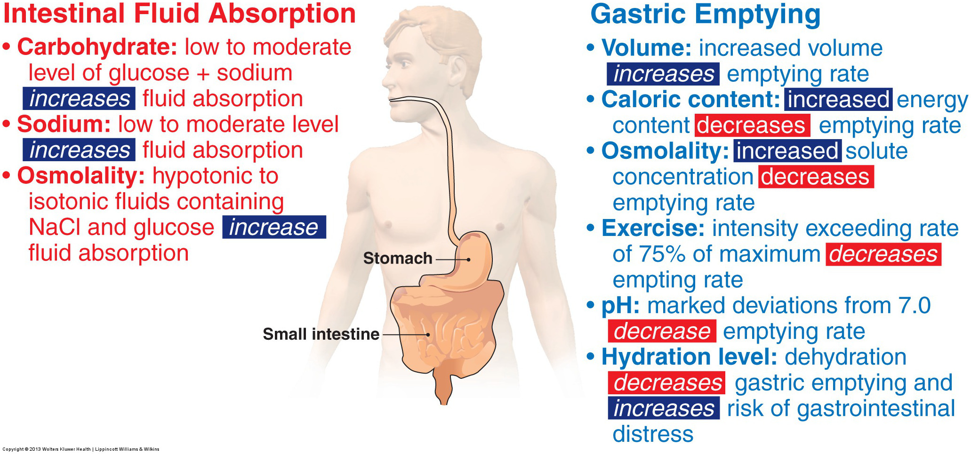
Notes:
Major factors that affect gastric emptying and fluid absorption.

Slide 17
Oral rehydration solutions
Provide additional glucose
Minimize the effects of dehydration on:
Cardiovascular dynamics
Temperature regulation
Exercise performance
Adding electrolytes aids in:
Maintaining thirst mechanism
Reducing the risk of hyponatremia

Slide 18
Carbohydrate-electrolyte beverages
The ideal hydration solution contains between 5% and 8% carbohydrates
This permits carbohydrate replenishment without adversely affection fluid balance
Maintains glucose metabolism and preserves glycogen during prolonged exercise
Notes:
Consuming this solution in recovery from prolonged exercise in a warm environment also improves endurance capacity for subsequent exercise.

Slide 19
Hydration during exercise
Adding sodium to the ingested fluids helps to maintain plasma sodium concentration
Benefits the ultra-endurance athlete at risk for hyponatremia
Reduces urine output and sustains the sodium-dependent osmotic drive to drink

Slide 20
